Slide 1
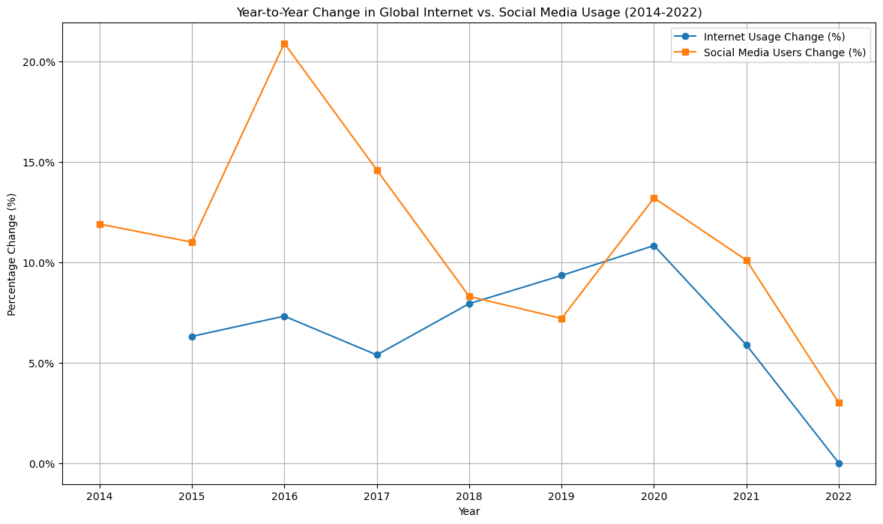
Section 3 Internet penetration vs. Social media penetration By Gerardo lopez rodriguez
Graph depicts year to year percentage change global internet usage and social media usage, 2014-2022
Social Media saw significant spike in growth in 2016 by ( 20.9) with a gradual decline of 3.0%
Internet usage growth peak in 2020 by 10.83% and then stabilized

Slide 2
The peak in social media growth in 2016 could be attributed global events, technological advancements and online engagement.
The spike internet usage in 2020 is likely linked to the global COVID-19 Pandemic which necessitated remote work, learning and socialization.
Internet and social media penetration are closely related but saturation levels are influence by a mix set of factors.
( Cultural, Technological , economical, among others.
The line plot data illustrates this information.

